Slide 1
Build a Employee Travel Approval Application for corporates
College name: Bharathi Womens College
Department: III B.Sc. Physics
Team ID : NM2023TMID04313
Team Leader : POOJA P
Team member : MONISHA S
Team member : SWETHA R
Team member : VAISHNAVI M

Slide 2
What Is Salesforce? Salesforce is your customer success platform, designed to help you sell, service, market, analyze, and connect
with your customers.
Project Description The project aim is to provide real-time knowledge for all the students who have basic knowledge of Salesforce and Looking for a real-time project. This project will also help to those professionals who are in cross-technology and wanted to switch to Salesforce with the help of this project they will gain knowledge and can include into their resume as well.

Slide 3
Introduction :
CREATE SALESFORCE ORG
CREATING THE APPLICATION
WHAT IS AN OBJECT
WHAT IS A TAB
CREATE - FIELDS& RELATIONSHIPS
IMPORT DEPARTMENTS
CUSTOMIZE USER INTERFACE
USE CUSTOMIZATION
ADD BUSINESS LOGIC TO TRAVEL APP
WHAT ARE REPORTS
DASHBOARDS

Slide 4
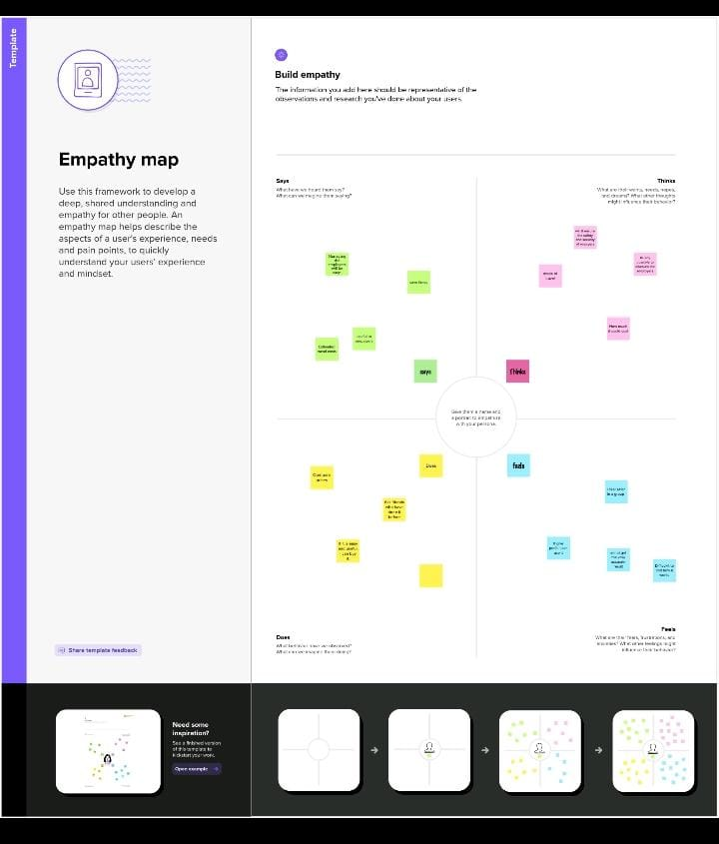
Empathy map :

Slide 5
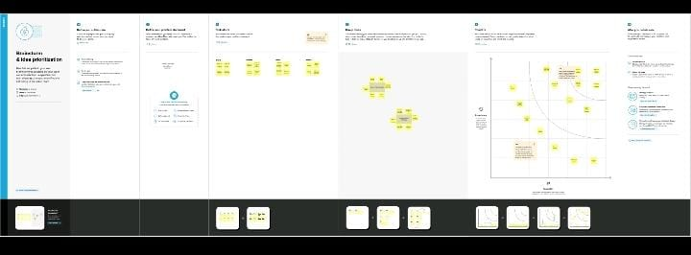
Brainstorm & idea prioritization :

Slide 6
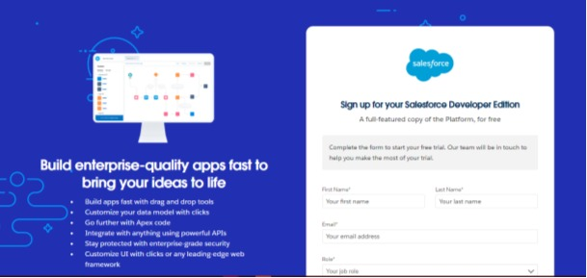
Milestone 1
Create Salesforce Org:
Activity 1

Slide 7
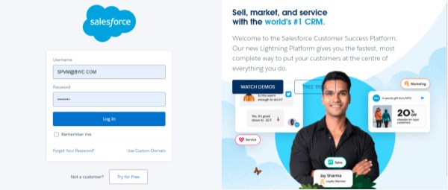
Activity 2

Slide 8
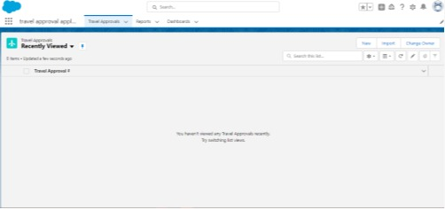
Milestone 2
Creating the Application:

Slide 9
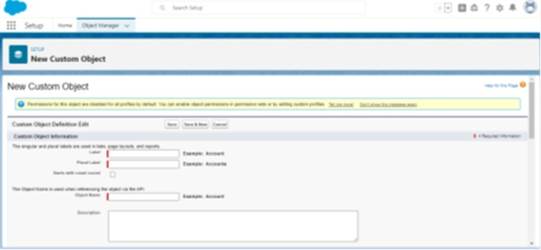
Milestone 3
What is an object?:
Activity 1

Slide 10
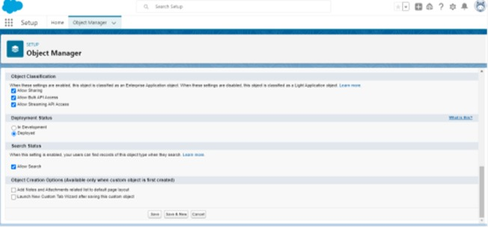
Activity 2

Slide 11
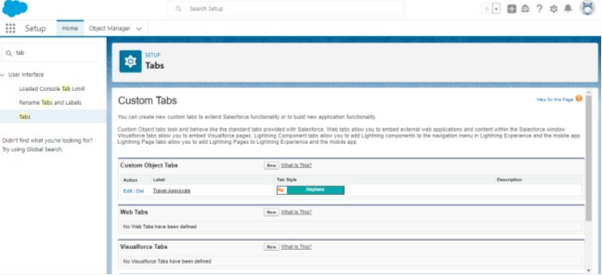
Milestone 4
What is a Tab?
Activity 1

Slide 12
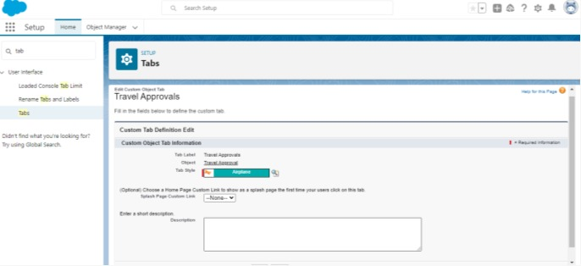
Activity 2

Slide 13
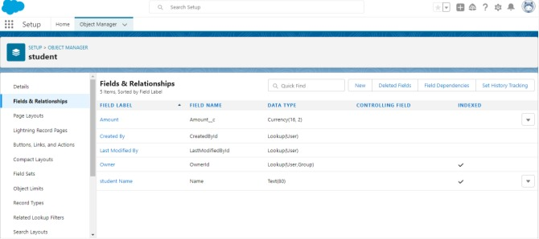
Milestone 5
Create- Fields& Relationships :
Activity 1

Slide 14
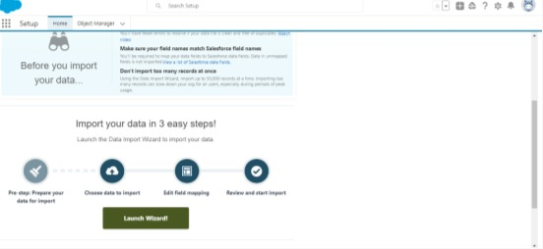
Milestone 6
Import Departments
Activity 1

Slide 15
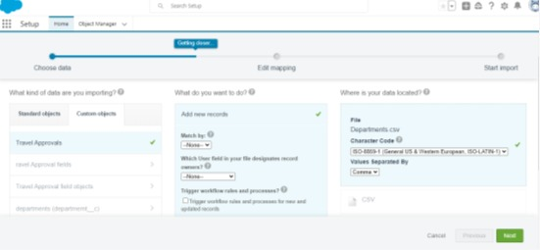
Activity 2

Slide 16
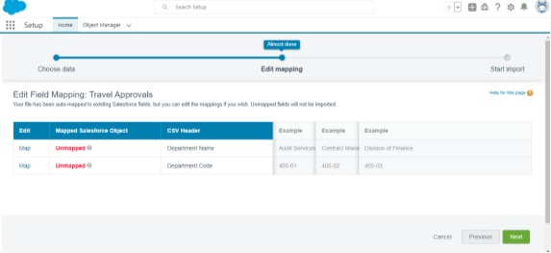
Activity 3

Slide 17
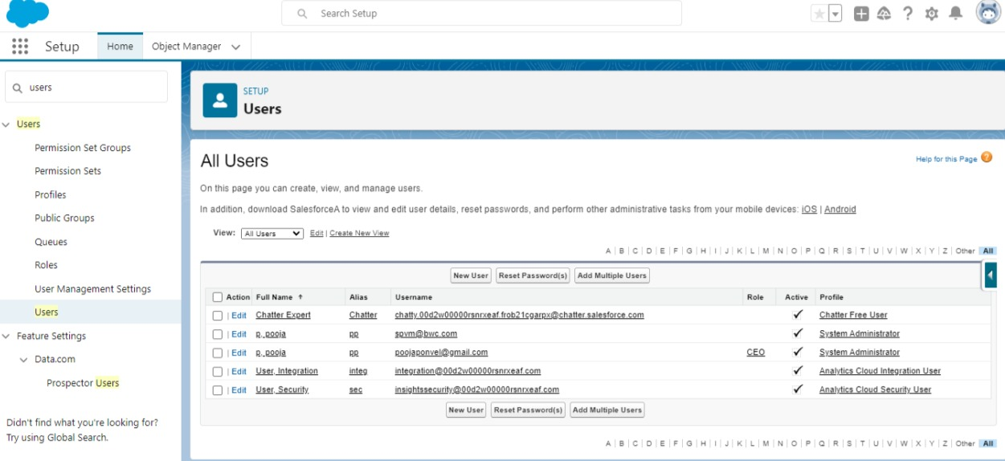
Milestone 7
Customize User Interface
Activity 1

Slide 18
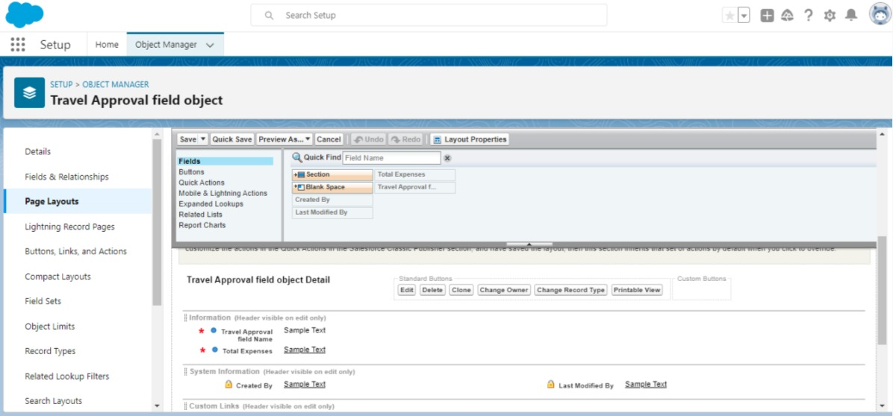
Activity 2

Slide 19
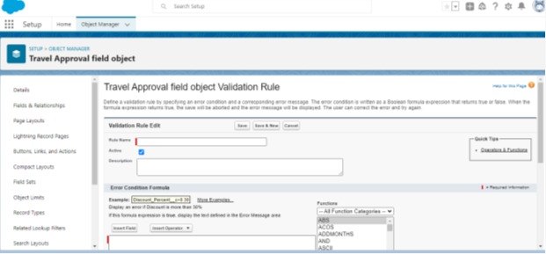
Milestone 8
Use customization
Activity 1

Slide 20
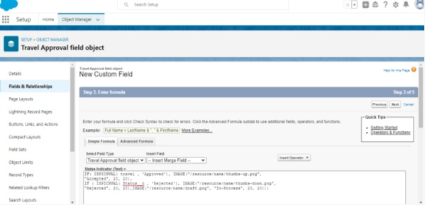
Activity 2

Slide 21
Milestone 9
Add Business Logic to Travel App
Activity 1

Slide 22
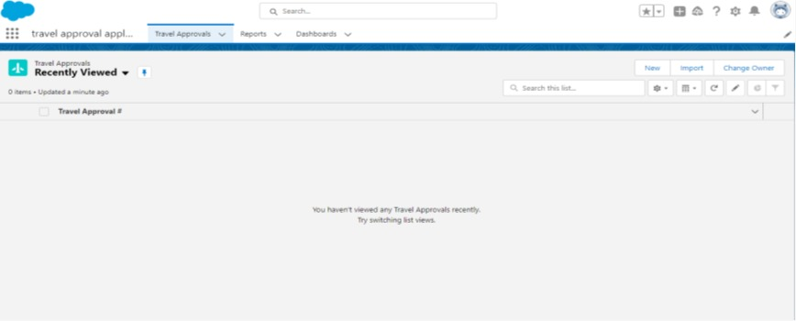
Milestone 10
What are Reports?
Activity 1

Slide 23
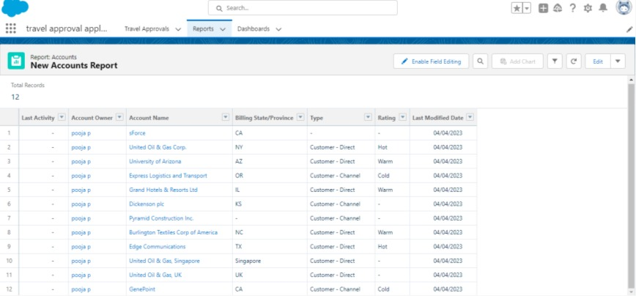
Activity 2

Slide 24
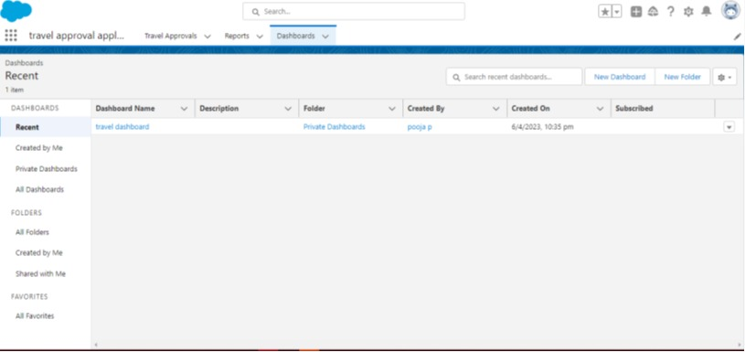
Milestone 11
Dashboards:
Activity 1

Slide 25
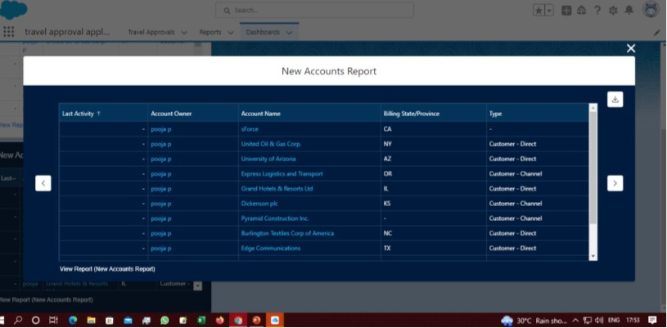
Activity 2

Slide 26
Thank you

